Slide 1
ECE2002-ANALOG ELECTRONIC CIRCUIT
TEMPERATURE CONTROLLED FAN
Proposed by:
Ishita Narang(20BEC180)
Project Guide: Prof. Jasmin Pameena Priyadarshini M

Slide 2

Submitted by
Name : Ishita Narang
Reg No: 20BEC0180

Slide 3
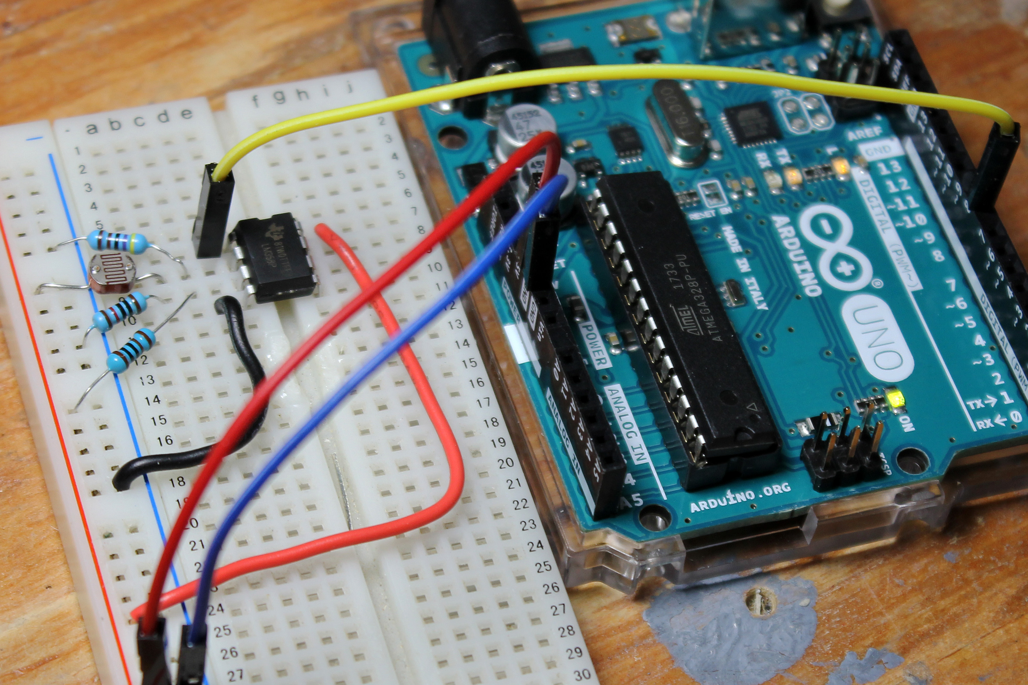
INTRODUCTION
In this project, we are going to build a temperature-controlled fan using Arduino. With this circuit, we will be able to adjust the fan speed in our home or office according to the room temperature and also show the temperature and fan speed changes on a 16x2 LCD display. To do this we will be using an Arduino UNO Board, resistors, capacitor, connecting wires LCD,LM35 temp sensor, diode , mosfet ,potentiometer and DC fan that is controlled by using PWM.
PWM is a technique by which we can control the voltage or power. For example ,if you are applying 5 volt for driving a motor then motor will moving with some speed, now if we reduces applied voltage by 2 means we apply 3 volts to motor then motor speed also decreases. This concept is used in the project to control the voltage using PWM.

Slide 4
COMPONENTS REQUIRED:
LM35 Temperature Sensor
Capacitor (10μ)
Arduino UNO
Potentiometer
16×2 LCD screen
Resistors
IRFZ44N MOSFET
Dc fan
Diode

Slide 5
FUNCTION OF MAIN COMPONENTS:
LM35 Temperature sensor: It is an electronic device that measures the temperature of its environment and convert the input data into electronic data to record .It is a measuring device having an analog output voltage proportional to temperature.
MOSFET : The power MOSFET is used to amplify the signal(voltage) and to switch rapidly according to pwm input.
Diode: It is used alongside a DC fan to prevent voltage spikes while switching of the circuit.
Arduino UNO: It will read the temperature value from the sensor.
LCD display: The LCD screen will display the temperature and the fan speed

Slide 6
APPLICATION:
Generally we use a regulator to increase or decrease the speed of fan but with the help of this circuit we can easily rules out the use of regulator because it automates the fan according to room temperature.
On the other hand, this circuit can also be used in industries ,like during an industrial process when the temperature exceeds its maximum value, the sensor sense it out and in result of it the fan starts working acting as an coolant which helps to lower down the surrounding temperature.

Slide 7
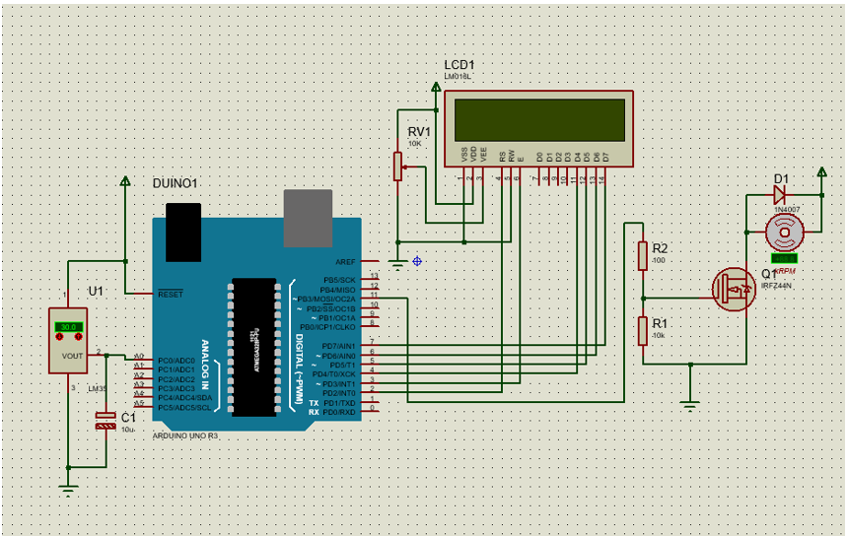
CIRCUIT DIAGRAM:

Slide 8
This project consists of three sections. One senses the temperature by using temperature sensor namely LM35. The second section reads the LM35 sensor module’s output and extracts temperature value into a suitable number in Celsius scale and control the fan speed by using PWM. And last part of system shows humidity and temperature on LCD and Fan driver.
Here in this project, we have used a sensor module namely LM35. Here we have only used this LM35 sensor for sensing temperature, and then programmed our Arduino according to the requirements.
Working on this project is very simple. We have created PWM at PWM pin of Arduino and applied it at base terminal of the transistor. Then transistor creates a voltage according to the PWM input.

Slide 9
WORKING
As the temperature is proportional to the output voltage, so whenever there is a rise in surrounding temperature so output voltage also increases which results in increase of fan speed.
Here the minimum temperature is set as 30֯ and maximum temperature as 45֯. That means when the temperature is around 30֯ the fan speed is at minimum while at 45 ֯temperature the fan speed is maximum that is 100%.
PWM output is generated by the Arduino at pin 11 which is connected to the fan. Voltage Divider bias is used to increase/decrease the voltage drop at the gate terminal of the MOSFET. MOSFETs are better for high-power applications because they can switch faster than BJTs.
Diode is used alongside a DC fan to prevent voltage spikes while switching of the circuit .It provides a path for the current to flow when power is disconnected.

Slide 10
The MOSFET will experience average voltage of each time period. More the voltage is as a result duty cycle is higher(time for which it is ON) more the fan speed so this way we can vary the voltage and control the speed of the fan.
PWM works by pulsating DC current, and varying the amount of time that each pulse stays ‘on’ to control the amount of current that flows to a device . If the duty cycle of a PWM power supply is set to 70%, then the pulse is on for 70% of the time, and it is off 30% of the time. Duty cycle refers the amount of time it is on.

Slide 11
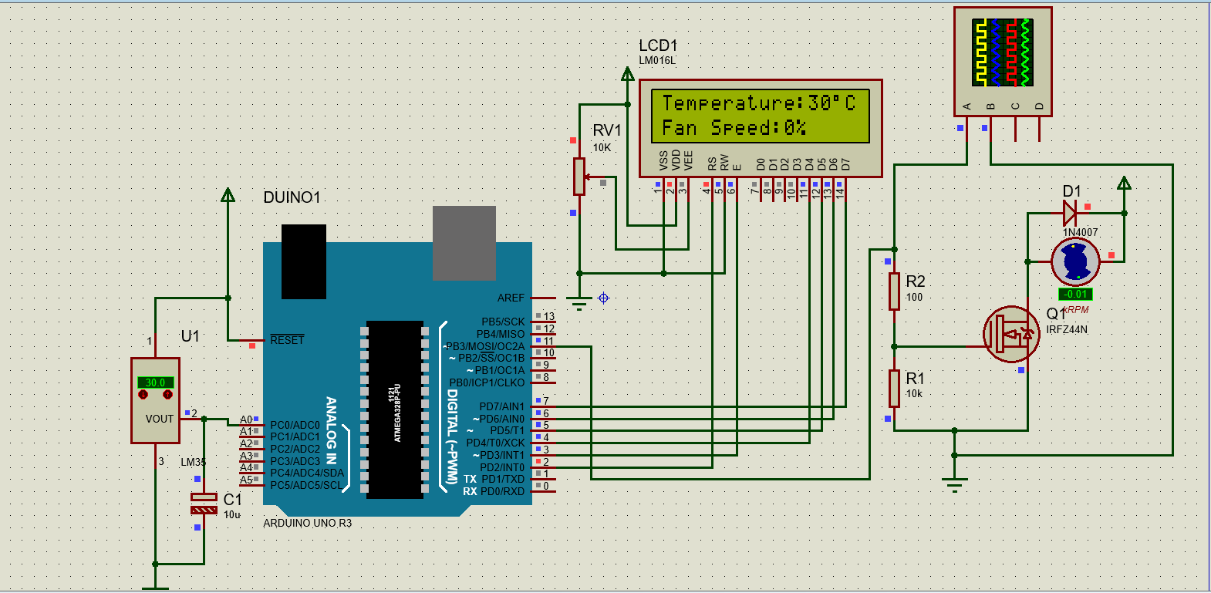
STIMULATION
At minimum temperature set (30 °C) fan speed = 0%

Slide 12

STIMULATION
At a temperature of 37 °C fan speed = 46%

Slide 13

STIMULATION
At maximum temperature set (45 °C) fan speed = 100%

Slide 14
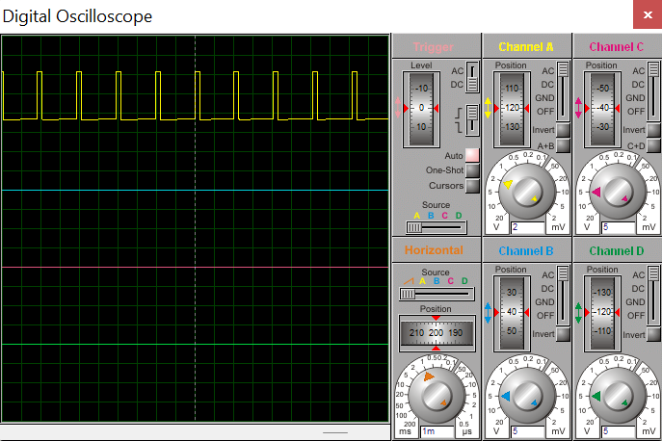

PWM
10% duty cycle
Off for 90% of the time
Temp=30℃ and Fan speed = 0%
50% duty cycle
Off for 50% of the time and On for 50%
Temp=38℃ and Fan speed = 50%

Slide 15
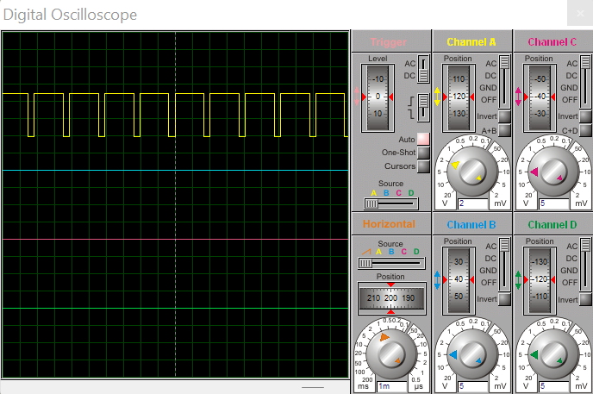
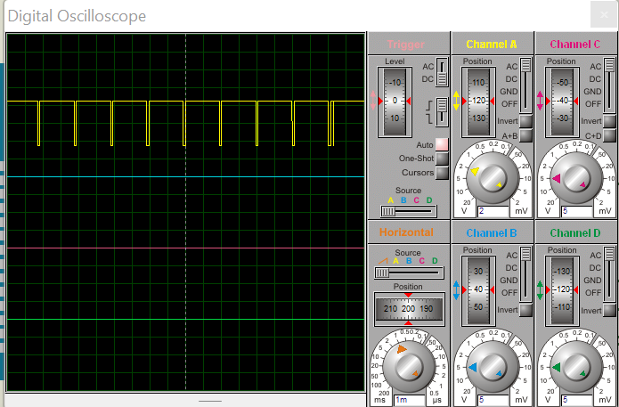
PWM
80% duty cycle
Off for 20% of the time
Temp=42℃ and Fan speed = 80%
90% duty cycle
Off for 10% of the time
Temp=45℃ and Fan speed = 100%

Slide 16
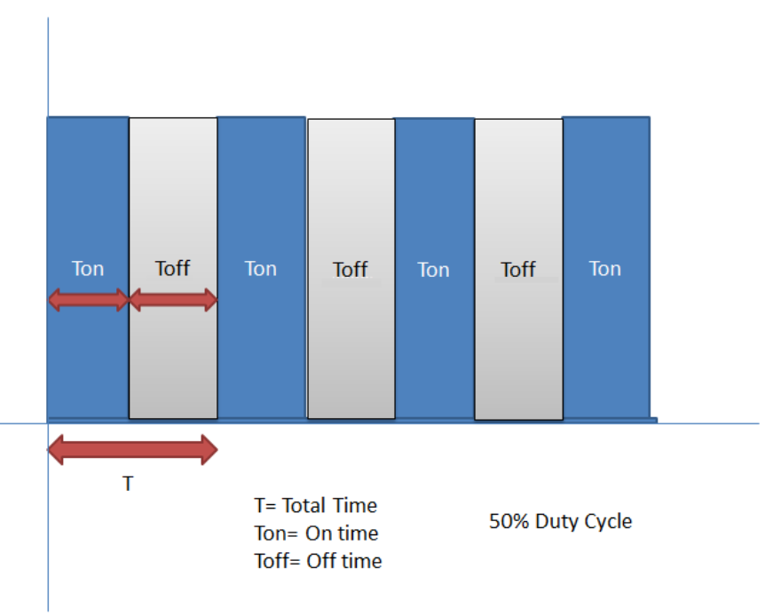
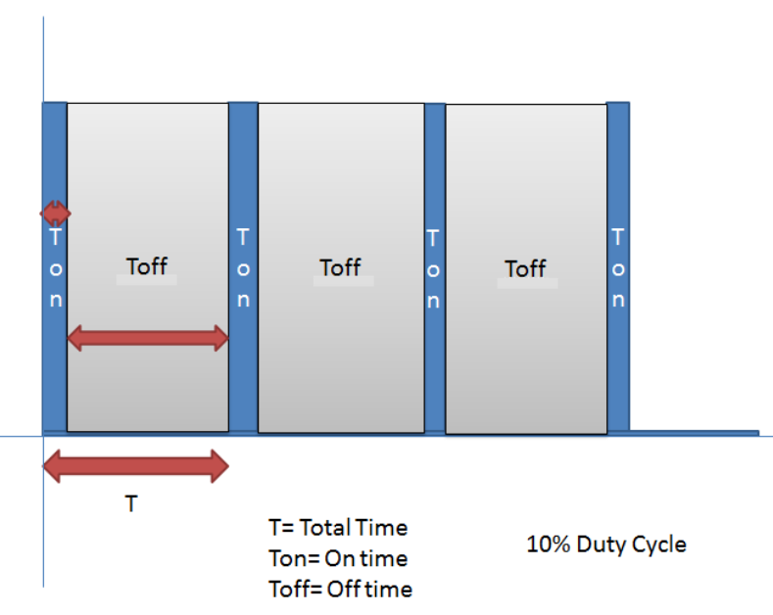
The main game of PWM is digital pulse with some duty cycle and this duty cycle is responsible for controlling the speed or voltage. Suppose we have a pulse with duty cycle 50% that means it will give half of voltage that we apply.

Slide 17
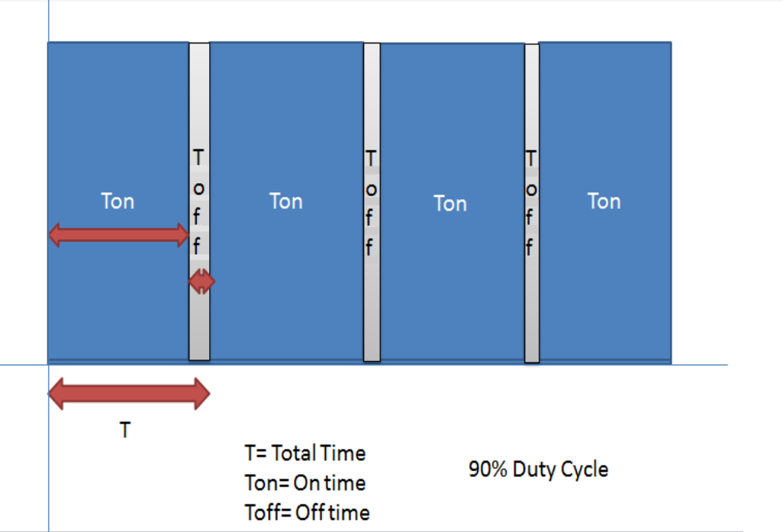
Formula for duty cycle given below:
Duty Cycle= Ton/T
Where T= total time or Ton + Toff
And Ton= On time of pulse (means 1 )
And Toff= Off time of pulse (means 0)

Slide 18
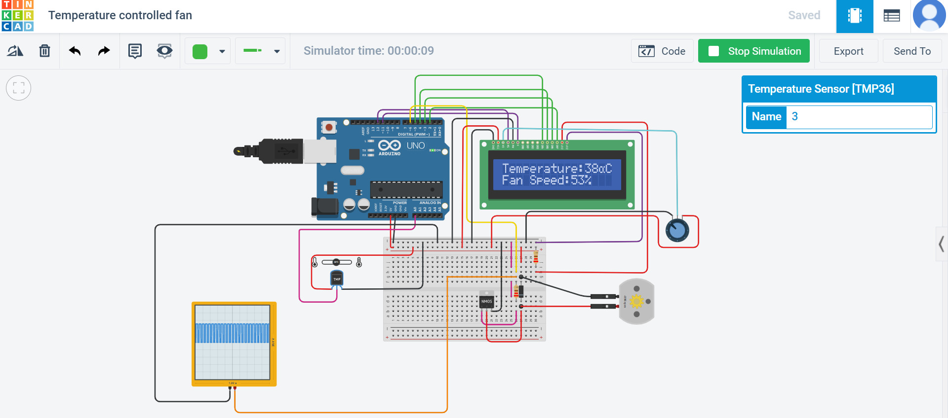
STIMULATION IN TINKERCAD

Slide 19
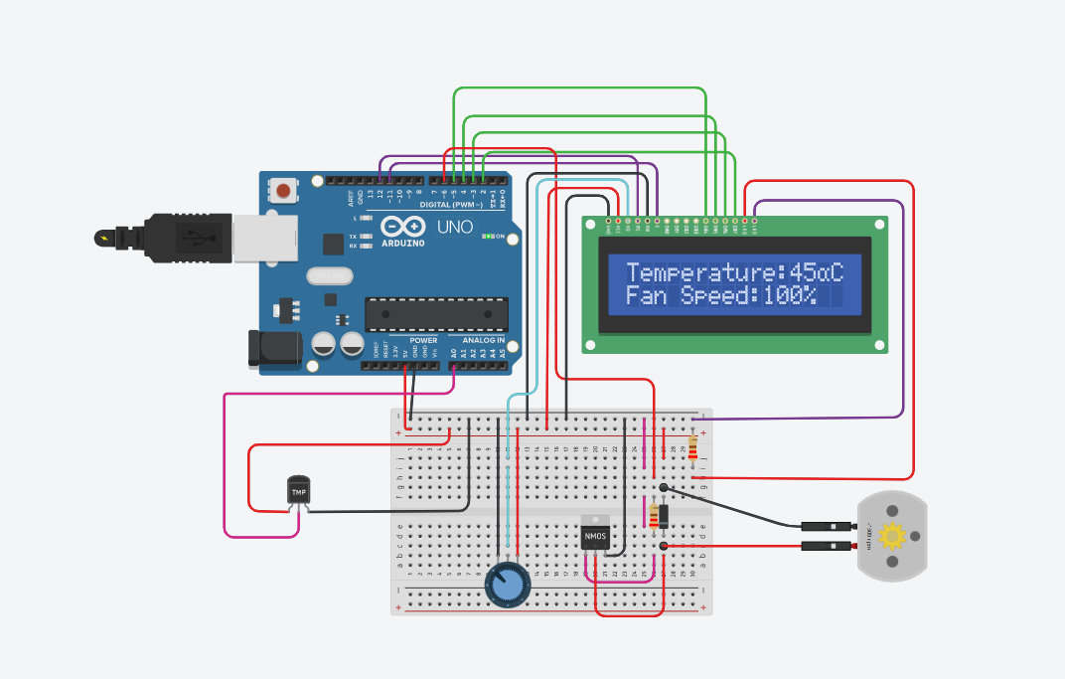
At maximum temperature set (45 °C) fan speed = 100%

Slide 20
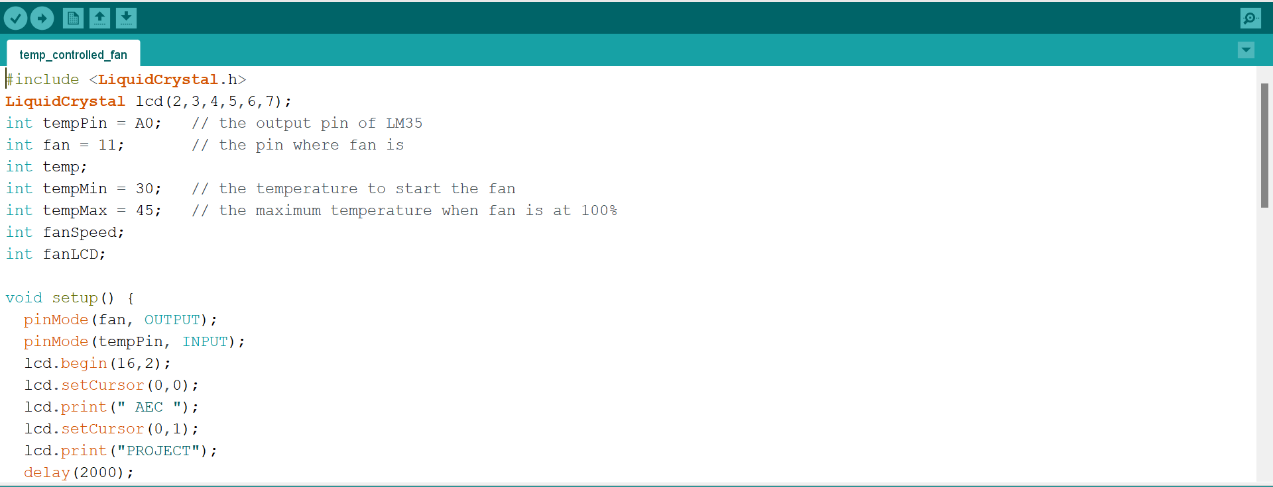
ARDUINO CODE

Slide 21
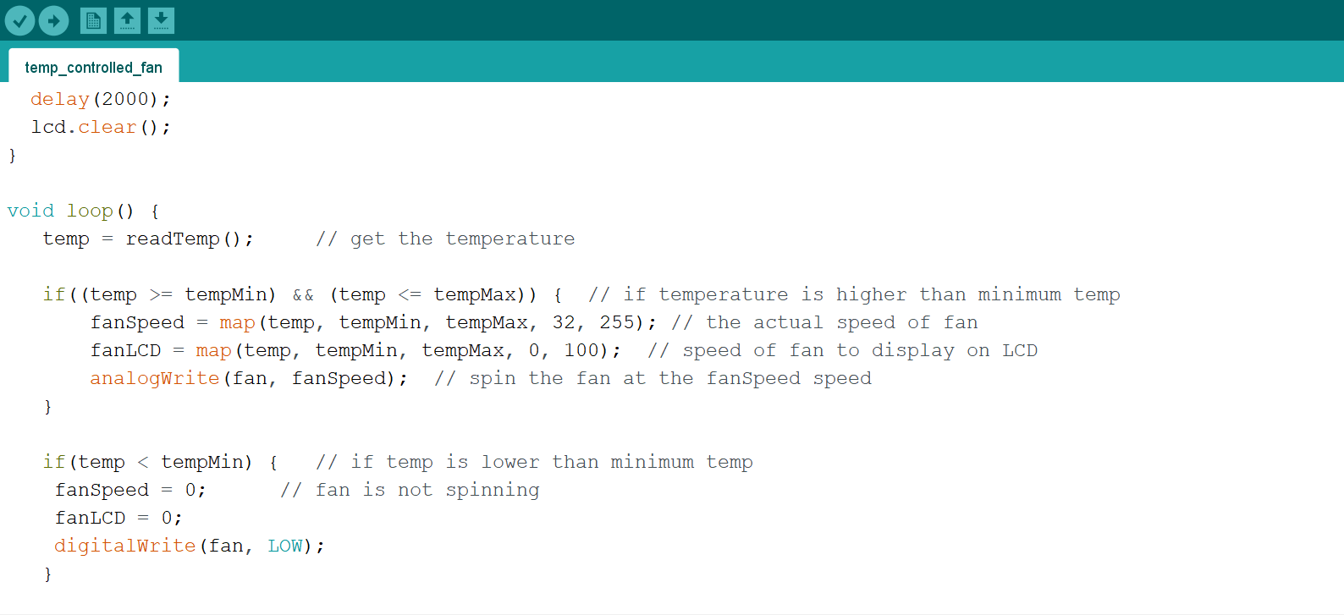

Slide 22
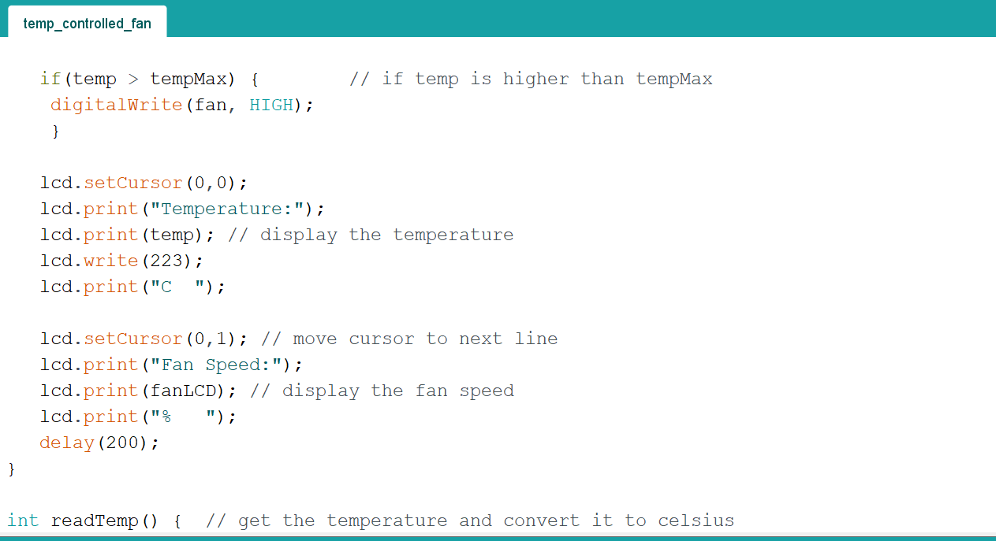


Slide 23
RESULT
The electric fan operates automatically according to temperature rises in order to compensate the rise in the temperature and turns off when the temperature returns back to the normal temperature .This circuit can cool the heat generating electronic devices by operating a DC fan when the temperature in its vicinity increases above the present level.

Slide 24
CONCLUSION
This circuit is very simple and easy to build . Speed varies automatically ,so that this circuit controls the speed without using it manually. Saves energy by slowing down the fan speed during low temperature.
This circuit is really helpful to disabled people. So the system which is designed in this work performed very well and can be classified as automatic control.

Slide 25
REFERENCES
https://circuitdigest.com/microcontroller-projects/automatic-temperature-controlled-fan-project
https://create.arduino.cc/projecthub/embeddedlab786/temperature-based-fan-speed-control-945f9d
https://www.ekwb.com/blog/what-is-pwm-and-how-does-it-work/

Slide 26
THANK YOU

